Slide 1

Employee Management System
by
Kushal Vas Vangari (381)
Shrutakeerti Daggubati (382)
Jayatejaswini (381)
Kavya Gorre (382)

Slide 2




OUR TEAM
Shrutakeerti Daggubati
Kushal Vas
Vangari
Jayatejaswini
Kavya Gorre
381
382
382
381
B.com computer applications
B-Tech in A.I.
and M.L.
MSc International Business Economics and Finance
B.Tech in Electronics and
Communication
Learning data analytics is about taking control of my career path
Learning data analytics is about taking control of my career path
Learning data science to upskill in AI
To power ahead in my career
3+ Years Work Experience
Fresher
Fresher
1+ Years Work Experience

Slide 3
OBJECTIVE
Design and implement a system to efficiently manage employee data, including personal details, job roles, salaries, qualifications, leave records, and payroll.
The system uses relational tables with foreign keys to maintain data integrity and consistency.
Benifits
Improved HR Efficiency: Automates and streamlines employee data management, reducing manual work.
Data Accuracy & Insights: Ensures consistent, reliable data with powerful query and reporting capabilities.

Slide 4
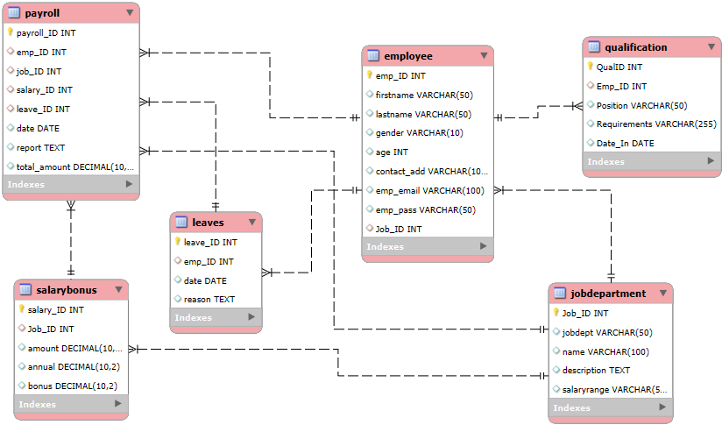
ER DIAGRAM

Slide 5

Key analysis
EMPLOYEE INSIGHTS
How many unique employees are currently in the system?
OUTPUT
SELECT COUNT
(DISTINCT emp_ID) AS unique_employee_count
FROM Employee;

Slide 6
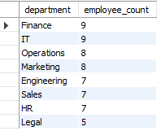
Which departments have the highest number of employees?
SELECT
jd.jobdept AS department,
COUNT(e.emp_ID) AS employee_count
FROM Employee e
JOIN JobDepartment jd ON e.Job_ID = jd.Job_ID
GROUP BY jd.jobdept
ORDER BY employee_count DESC;
OUTPUT

Slide 7
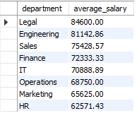
What is the average salary per department?
SELECT
jd.jobdept AS department,
ROUND(AVG(sb.amount), 2) AS average_salary
FROM Employee e
JOIN JobDepartment jd ON e.Job_ID = jd.Job_ID
JOIN
SalaryBonus sb ON e.Job_ID = sb.Job_ID
GROUP BY jd.jobdept
ORDER BY average_salary DESC;
OUTPUT

Slide 8
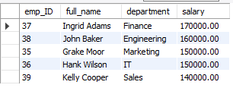
Who are the top 5 highest-paid employees?
SELECT e.emp_ID,
CONCAT(e.firstname, ' ', e.lastname) AS full_name,
jd.jobdept AS department,
sb.amount AS salary
FROM Employee e
JOIN JobDepartment jd ON e.Job_ID = jd.Job_ID
JOIN SalaryBonus sb ON e.Job_ID = sb.Job_ID
ORDER BY sb.amount DESC
LIMIT 5;
OUTPUT

Slide 9

What is the total salary expenditure across the company?
OUTPUT
SELECT SUM(sb.amount) AS total_salary_expenditure
FROM Employee e
JOIN SalaryBonus sb ON e.Job_ID = sb.Job_ID;

Slide 10
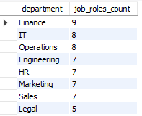
JOB ROLE AND DEPARTMENT ANALYSIS
How many different job roles exist in each department?
OUTPUT
SELECT jobdept AS department,
COUNT(DISTINCT name) AS job_roles_count
FROM JobDepartment
GROUP BY jobdept
ORDER BY job_roles_count DESC;

Slide 11
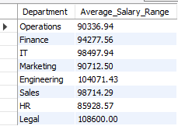
What is the average salary range per department?
SELECT jobdept AS Department,
ROUND(AVG((CAST(REPLACE (REPLACE(TRIM(SUBSTRING_INDEX(salaryrange, '-', 1)), '$', ''), ',', '') AS DECIMAL(10,2)) + CAST(REPLACE(REPLACE(TRIM(SUBSTRING_INDEX(salaryrange, '-', -1)), '$', ''), ',', '') AS DECIMAL(10,2))) / 2), 2) AS Average_Salary_Range
FROM jobdepartment
WHERE salaryrange LIKE '%-%'
GROUP BY jobdept;
OUTPUT

Slide 12
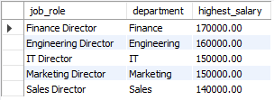
Which job roles offer the highest salary?
SELECT jd.name AS job_role,
jd.jobdept AS department,
MAX(sb.amount) AS highest_salary
FROM JobDepartment jd
JOIN SalaryBonus sb ON jd.Job_ID = sb.Job_ID
GROUP BY jd.name, jd.jobdept
ORDER BY highest_salary DESC
LIMIT 5;
OUTPUT

Slide 13
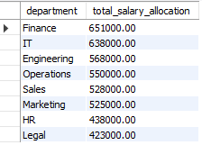
Which departments have the highest total salary allocation?
SELECT jd.jobdept AS department,
SUM(sb.amount) AS total_salary_allocation
FROM Employee e
JOIN JobDepartment jd ON e.Job_ID = jd.Job_ID
JOIN SalaryBonus sb ON e.Job_ID = sb.Job_ID
GROUP BY jd.jobdept
ORDER BY total_salary_allocation DESC;
OUTPUT

Slide 14

QUALIFICATION AND SKILLS ANALYSIS
How many employees have at least one qualification listed?
SELECT COUNT(DISTINCT q.Emp_ID) AS employees_with_qualifications
FROM Qualification q
WHERE TRIM(q.Requirements) != ''
AND LENGTH(q.Requirements) - LENGTH(REPLACE(q.Requirements, ' ', '')) + 1 > 0;
OUTPUT

Slide 15
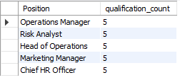
Which positions require the most qualifications?
OUTPUT
SELECT Position,
LENGTH(Requirements) - LENGTH(REPLACE(Requirements, ' ', '')) + 1 AS qualification_count
FROM Qualification
ORDER BY qualification_count DESC
LIMIT 10;

Slide 16
What is the average number of qualifications per department?
SELECT jd.jobdept AS department,ROUND(AVG(word_count), 2) AS avg_qualifications_per_employee
FROM (SELECT e.emp_ID,e.Job_ID,
COALESCE(SUM(LENGTH(q.Requirements) -LENGTH(REPLACE(q.Requirements, ' ', '')) + 1), 0) AS word_count
FROM Employee e
LEFT JOIN Qualification q ON e.emp_ID = q.Emp_ID
GROUP BY e.emp_ID, e.Job_ID
) AS emp_qual_counts
JOIN JobDepartment jd ON emp_qual_counts.Job_ID = jd.Job_ID
GROUP BY jd.jobdept
ORDER BY avg_qualifications_per_employee DESC;

Slide 17
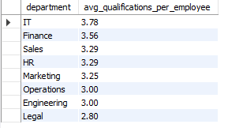
OUTPUT

Slide 18

LEAVE AND ABSENCE PATTERNS
Which year had the most employees taking leaves?
SELECT YEAR(date) AS leave_year,
COUNT(DISTINCT emp_ID) AS employees_on_leave
FROM Leaves
GROUP BY leave_year
ORDER BY employees_on_leave DESC
LIMIT 2;
OUTPUT

Slide 19
What is the average number of leave days taken by its employees per department?
SELECT jd.jobdept AS department, ROUND(AVG(emp_leave_count.total_leaves), 2) AS avg_leave_days_per_employee
FROM (
SELECT e.emp_ID, e.Job_ID,
COUNT(l.leave_ID) AS total_leaves
FROM Employee e
LEFT JOIN Leaves l ON e.emp_ID = l.emp_ID
GROUP BY e.emp_ID, e.Job_ID
) AS emp_leave_count
JOIN JobDepartment jd ON emp_leave_count.Job_ID = jd.Job_ID
GROUP BY jd.jobdept
ORDER BY avg_leave_days_per_employee DESC;

Slide 20
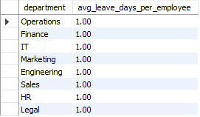
OUTPUT

Slide 21
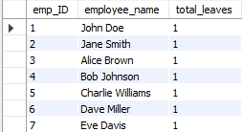
Which employees have taken the most leaves?
SELECT e.emp_ID,
CONCAT(e.firstname, ' ', e.lastname) AS employee_name,
COUNT(l.leave_ID) AS total_leaves
FROM Employee e
JOIN Leaves l ON e.emp_ID = l.emp_ID
GROUP BY e.emp_ID
ORDER BY total_leaves DESC;
OUTPUT

Slide 22

What is the total number of leave days taken company-wide?
OUTPUT
SELECT COUNT(*) AS total_leave_days
FROM Leaves;

Slide 23
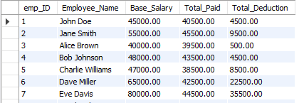
How do leave days correlate with payroll amounts?
SELECT e.emp_ID, CONCAT(e.firstname, ' ', e.lastname) AS Employee_Name, sb.amount AS Base_Salary, SUM(p.total_amount) AS Total_Paid, (sb.amount - SUM(p.total_amount)) AS Total_Deduction
FROM Employee e
JOIN Payroll p ON e.emp_ID = p.emp_ID
JOIN SalaryBonus sb ON p.salary_ID = sb.salary_ID
GROUP BY e.emp_ID, Employee_Name, sb.amount
ORDER BY e.emp_ID;
OUTPUT

Slide 24
PAYROLL AND COMPENSATION ANALYSIS
What is the total monthly payroll processed?
SELECT pm.payroll_month, pm.total_monthly_payroll, COALESCE (lv.total_leave_days, 0) AS total_leave_days
FROM (SELECT DATE_FORMAT(date, '%Y-%m') AS payroll_month, SUM(total_amount) AS total_monthly_payroll
FROM Payroll
GROUP BY payroll_month) pm
LEFT JOIN (SELECT DATE_FORMAT(date, '%Y-%m') AS leave_month, COUNT(*) AS total_leave_days
FROM Leaves
GROUP BY leave_month) lv ON pm.payroll_month = lv.leave_month
ORDER BY pm.payroll_month;

Slide 25

OUTPUT

Slide 26
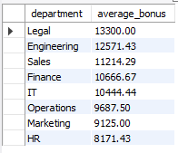
What is the average bonus given per department?
SELECT jd.jobdept AS department,
ROUND(AVG(sb.bonus), 2) AS average_bonus
FROM SalaryBonus sb
JOIN JobDepartment jd ON sb.Job_ID = jd.Job_ID
GROUP BY jd.jobdept
ORDER BY average_bonus DESC;
OUTPUT

Slide 27
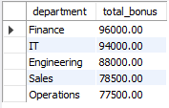
Which department receives the highest total bonuses?
SELECT jd.jobdept AS department,
SUM(sb.bonus) AS total_bonus
FROM SalaryBonus sb
JOIN JobDepartment jd ON sb.Job_ID = jd.Job_ID
GROUP BY jd.jobdept
ORDER BY total_bonus DESC
LIMIT 5;
OUTPUT

Slide 28

What is the average net salary after all deductions?
OUTPUT
SELECT ROUND(AVG(total_amount), 2) AS average_net_salary
FROM Payroll;

Slide 29
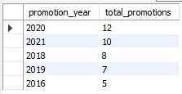
EMPLOYEE PERFORMANCE AND GROWTH
Which year had the highest number of employee promotions?
SELECT YEAR(Date_In) AS promotion_year, COUNT(*) AS total_promotions
FROM Qualification
GROUP BY promotion_year
ORDER BY total_promotions DESC
LIMIT 5;
OUTPUT

Slide 30
Final business insights
Despite employees taking the same number of leaves, their salary deductions differ. Possible Causes Identified:
Presence of taxes and additional deductions.
Inconsistent salary records – some employees may be receiving higher pay than documented.
All employees have the same password, posing a serious privacy and data security risk.
Only one employee took leave per day, indicating well-managed leave distribution and strong team coordination.
Recommendations
Clearly mention percentage of tax and other deductions to improve transparency and salary analysis.
Ensure unique passwords for every employee.
No two employees should have the same password to maintain data security
Re-verify salaries and deductions for accuracy.
Pay special attention to employees receiving more than the documented salary.

Slide 31
Experience/Challenges working on the Project
Observed that all the employees Qualifications intially showed 1 per Role but after checking the Qualifiction Table I observed that the qualifications are not sapreated by comma only its saperated by spaces for I re-wrote the code accordingly then retrived the answer.
Working on the Employee Management System (EMS) project helped me understand how real-world HR data is stored and managed using SQL. I created six connected tables to handle employees, job roles, departments, salaries, qualifications, leaves, and payroll

Slide 32

Any Questions ?

Slide 33

THANK YOU

